Slide 1

Closed-Loop Control of a High Efficiency
SiC-based Dual Active Bridge Converter
for EV Battery Charging
Name: Medipally Saivivek
Roll No:- 122EE0378
Project Supervisor: Prof. Monalisa Pattnaik
Date: 10/10/25
Department of Electrical Engineering
National Institute of Technology, Rourkela

Slide 2
Overview
1. | Introduction | Pg. 1
2. | Literature review | Pg.2
3. | Motivation and Objective | Pg. 3
4. | DAB Converter for Battery Charging | Pg. 4
5. | SPS Control Strategy | Pg. 5
6. | System Configuration | Pg. 6
7. | Converter Design | Pg. 7
8. | Simulation Results | Pg. 8-10
9. | Conclusion | Pg. 11
10. | Future Plan | Pg. 12

Slide 3
Introduction
The Dual Active Bridge Converter(DAB) is a galvanically isolated bidirectional converter that regulates power transfer through phase-shift control between its two active bridges.
IGBT-based converters have certain drawbacks such as low switching frequency, longer turn-off time, and high conduction and switching losses, leading to reduced efficiency and larger size.
Adoption of wide-bandgap devices, especially Silicon Carbide (SiC) MOSFETs, has revolutionized converter performance by enabling higher switching frequencies, lower ON-state resistance.
As a result , SiC-based DAB converters enable the use of smaller passive components, reduce power losses, and significantly enhance overall system efficiency.
Work done till date:
Simulated a SiC-based Dual Active Bridge (DAB) converter in MATLAB/Simulink using the Single-Phase Shift (SPS) control strategy for EV battery charging.
Operated the system in open-loop mode to analyze power transfer characteristics between 400 V input and 60 V battery load.
Varied leakage inductance values to study their effect on output power, voltage, and efficiency.
Identified the optimum inductance (95 µH) achieving 96.78% efficiency and 4.12 kW output power.
1/12

Slide 4
Literature review
Traditional IGBT modules are unsuitable for high power density, high-frequency applications. Hence, MOS devices using advanced materials like SiC are being preferred in current research on DAB. [1]
DAB has attractive features like high power density , Bidirectional flow, soft-switching capability, low sensitivity to system parasites . Leakage inductance is the main energy transfer element, so it must be properly considered. [1]
DAB-IBDC is widely considered as the core circuit for next generation HFL PCSs due to its less transformer size and Galvanic isolation. [3]
Research on DAB-IBDC focused on characterization, control strategies, soft-switching techniques, and hardware optimization. [3]
The transmission power of an IBDC scales with the number of switches, giving DAB-IBDC (8 switches) the highest power capacity. [3]
Under SPS control, voltage mismatch across ports in a DAB causes high circulating power and limited zero-voltage switching. [4]
2/12

Slide 5
Motivation and Objectives
Motivation:
Medium-voltage batteries (60 V), commonly used in electric two-wheelers and light EVs, require high-efficiency converters to maximize driving range and minimize charging losses. To achieve this, wide-bandgap semiconductor devices, especially Silicon Carbide (SiC) MOSFETs, are essential due to their lower conduction losses and faster switching capability. SiC devices enable higher switching frequencies, resulting in smaller passive components and improved overall efficiency. Therefore, this project focuses on the design and development of a SiC-based Dual Active Bridge (DAB) converter aimed at high-efficiency EV battery charging applications.
Objectives:
To develop a SiC-based DAB converter model with SPS control for battery load. To optimize performance by analyzing the effect of leakage inductance and phase shift on efficiency and output power. To implement a closed-loop SPS control with CC–CV charging algorithm for precise regulation. To validate through hardware testing to confirm simulation accuracy and high-efficiency operation.
3/12

Slide 6
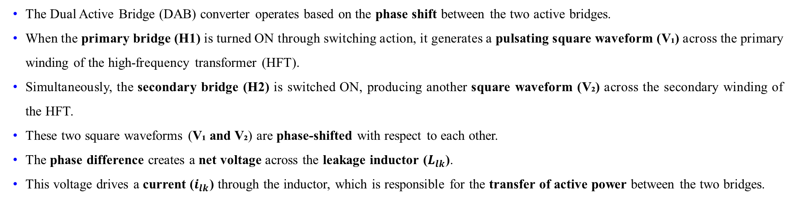
DAB Converter For Battery Charging
The Dual Active Bridge (DAB) converter operates based on the phase shift between the two active bridges.
When the primary bridge (H1) is turned ON through switching action, it generates a pulsating square waveform (V₁) across the primary winding of the high-frequency transformer (HFT).
Simultaneously, the secondary bridge (H2) is switched ON, producing another square waveform (V₂) across the secondary winding of the HFT.
These two square waveforms (V₁ and V₂) are phase-shifted with respect to each other.
The phase difference creates a net voltage across the leakage inductor ($L_{lk}$).
This voltage drives a current ($i_{lk}$) through the inductor, which is responsible for the transfer of active power between the two bridges.
4/12

Slide 7
SPS CONTROL STRATEGY
SPS Control Strategy:
SPS (Single Phase Shift) is the most widely used modulation technique for DAB converters due to its simplicity and reliable performance. Each bridge’s diagonal switches operate with a 50% duty cycle, creating phase-shifted square waves. The phase shift produces a voltage difference across the leakage inductance, generating a trapezoidal inductor current. The average inductor current determines the transferred power, which is proportional to input and output voltages and phase shift, and inversely to inductance and switching frequency. SPS enables bidirectional power flow i.e. positive phase shift transfers power from high to low voltage side and negative shift reverses it.
Switching Operation in SPS Control:
The primary and secondary voltages of the DAB transformer are square waves, determined by the conduction states of the switches in both bridges. The inductor voltage determines whether the current rises, falls, or stays constant, enabling precise control of power transfer between the two sides. In the first and third intervals, switches S1 & S3 (primary) and S5 & S7 (secondary) conduct, forming one polarity of operation. In the second and fourth intervals, switches S2 & S4 (primary) and S6 & S8 (secondary) conduct, reversing the polarity, thus completing the cyclic bidirectional power flow.
5/12

Slide 8
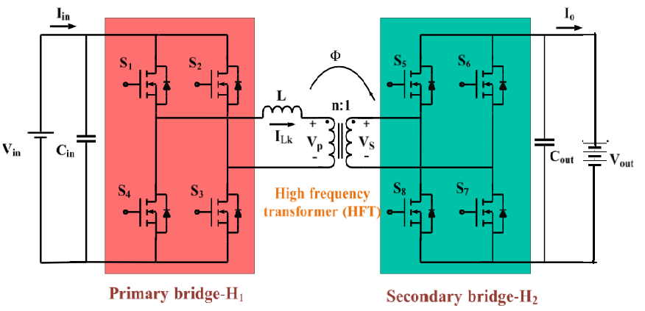
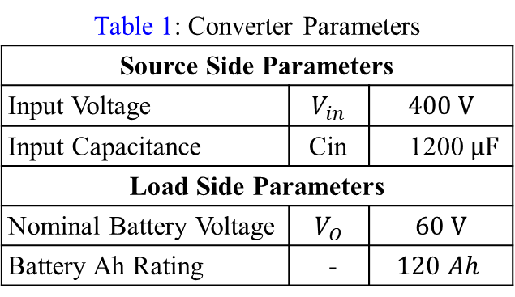
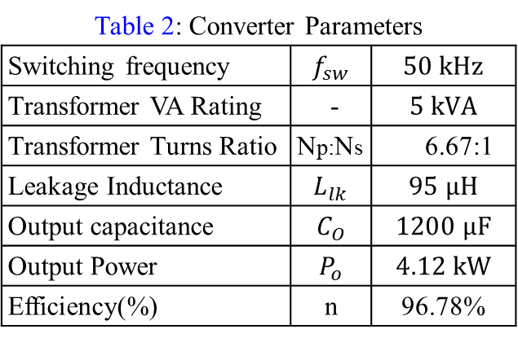
System Configuration
Table 1: Converter Parameters
Source Side Parameters
Input Voltage | $$V_{in}$$ | $$400 V$$
Input Capacitance | Cin | 1200 $µF$
Load Side Parameters
Nominal Battery Voltage | $$V_{O}$$ | $$60 V$$
Battery Ah Rating | - | $$120 Ah$$
On load side , the converter is connected to a battery with a nominal voltage of 60V and a capacity of 120-Ah with SOC of 60%. The switching frequency is set to 50 kHz , while the transformer is rated at 5 kVA with a turns ratio of 6.67:1 . The leakage inductance of the transformer is 95 µH . In order to handle voltage ripples effectively, an input capacitance of 1200 µF and an output capacitance of 1200 µF are provided.
Table 2: Converter Parameters
Switching frequency | $$f_{sw}$$ | $$50 kHz$$
Transformer VA Rating | - | $$5 kVA$$
Transformer Turns Ratio | Np:Ns | 6.67:1
Leakage Inductance | $$L_{lk}$$ | $$95 µH$$
Output capacitance | $$C_{O}$$ | $$1200 µF$$
Output Power | $$P_{o}$$ | $$4.12 kW$$
Efficiency(%) | n | 96.78%
Fig.1 SiC based Dual Active Bridge Converter
6/12

Slide 9

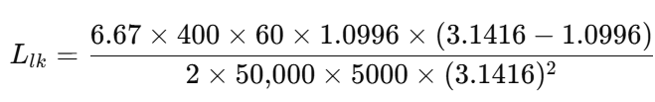



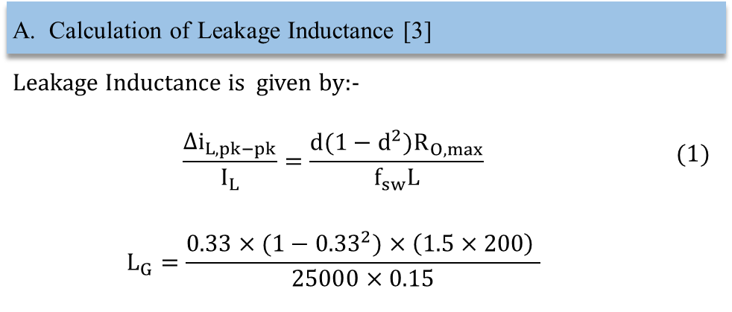
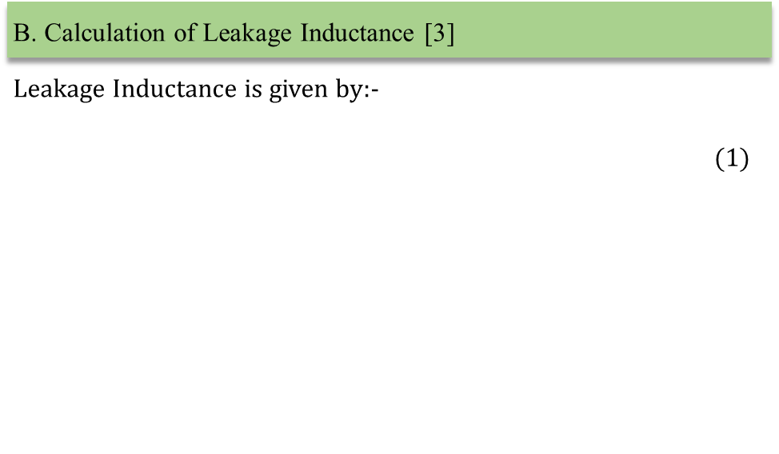
Calculation of Leakage Inductance
A. Calculation of Leakage Inductance [3]
Leakage Inductance is given by:- $$\frac{∆i_{L,pk−pk}}{I_{L}}=\frac{d(1−d^{2})R_{O,max}}{f_{sw}L}$$ | $$(1)$$
$$L_{G}=\frac{0.33×(1−{0.33}^{2})×\left(1.5×200\right) }{25000×0.15}$$
B. Calculation of Leakage Inductance [3]
Leakage Inductance is given by:- | $$(1)$$
The input voltage is taken as 400 V, and the turns ratio of the transformer is 6.67 : 1.
The desired output power of the converter is 5 kW, and the switching frequency is maintained at 50 kHz.
A phase shift of 63° was selected because it produced the desired output voltage and power transfer characteristics as per the design requirement.
The input voltage is taken as 480 V, and the turns ratio of the transformer is 6.67 : 1.
A 2 % ripple is considered for input voltage.
The desired output power of the converter is 5 kW, and the switching frequency is fixed at 50 kHz to ensure high-frequency operation with reduced transformer size.
7/12

Slide 10
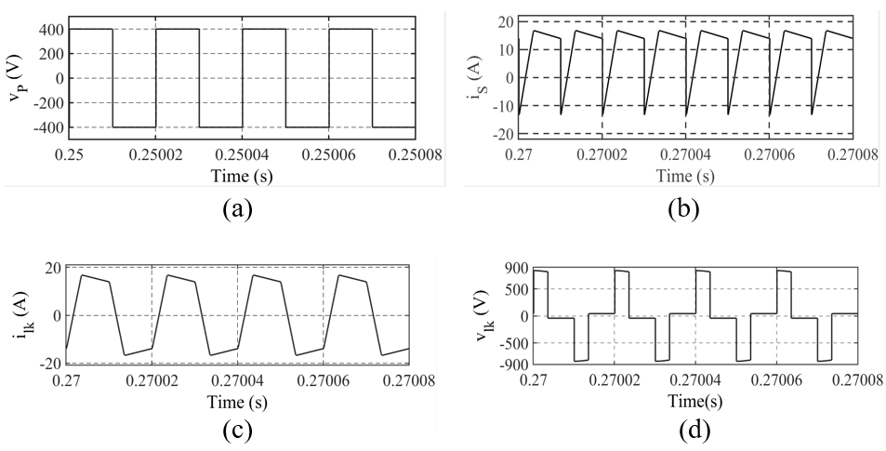
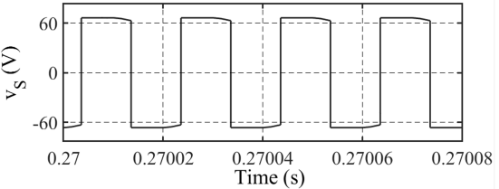
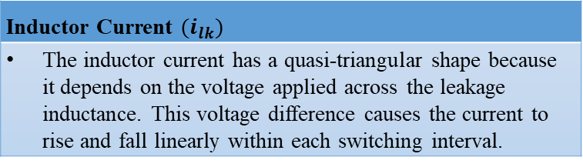
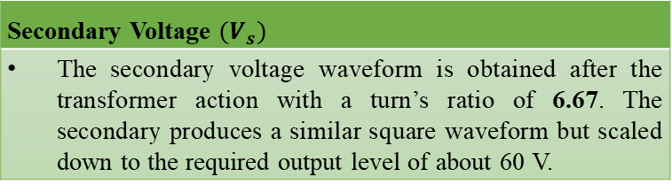
Simulation Results
Primary Voltage (Vp)
The full-bridge converter alternates between +400 V and −400 V in every switching cycle, which creates the required alternating voltage across the transformer primary.
Secondary Voltage $(V_{s})$
The secondary voltage waveform is obtained after the transformer action with a turn’s ratio of 6.67. The secondary produces a similar square waveform but scaled down to the required output level of about 60 V.
Inductor Current $(i_{lk})$
The inductor current has a quasi-triangular shape because it depends on the voltage applied across the leakage inductance. This voltage difference causes the current to rise and fall linearly within each switching interval.
Inductor Voltage (Vlk )
The inductor voltage is quasi-square since it represents the instantaneous difference between the voltages of the primary and secondary bridges.
Fig.2 Simulation waveforms of (a) Vp , (b) Vs , (c) $i_{lk}$, (d) $v_{lk}$
8/12

Slide 11
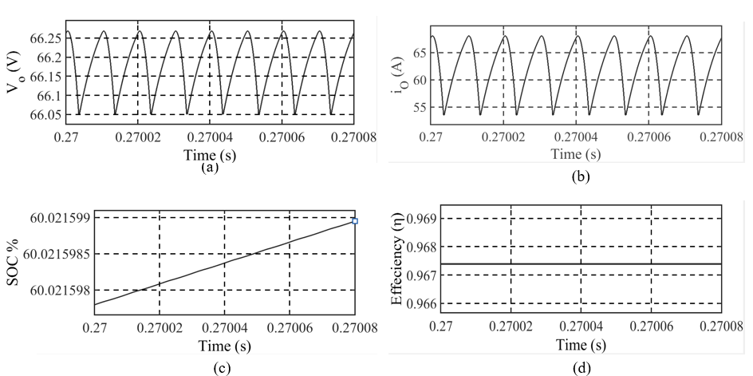
Simulation Results
Output Voltage (Vo)
The average output voltage remains around 66 V, the small voltage ripple occurs due to periodic energy transfer through the leakage inductance and the smoothing effect of the output capacitor.
Output Current (Io)
The output current follows a similar ripple pattern as the voltage. This happens because during each switching cycle, the instantaneous power transferred from the primary side fluctuates, causing minor current variations at the load end.
State of Charge (SOC)
The SOC curve shows a gradual increase, indicating that the battery is being charged. As the converter supplies current to the battery continuously, the stored energy rises steadily with time, leading to upward slope in the SOC percentage.
Efficiency ( η)
The efficiency remains almost constant at around 96.78 %, showing that power losses are minimal.
Fig.3 Simulation waveforms of (a) Vo, (b) io, (c) %SoC, (d) η
9/12

Slide 12
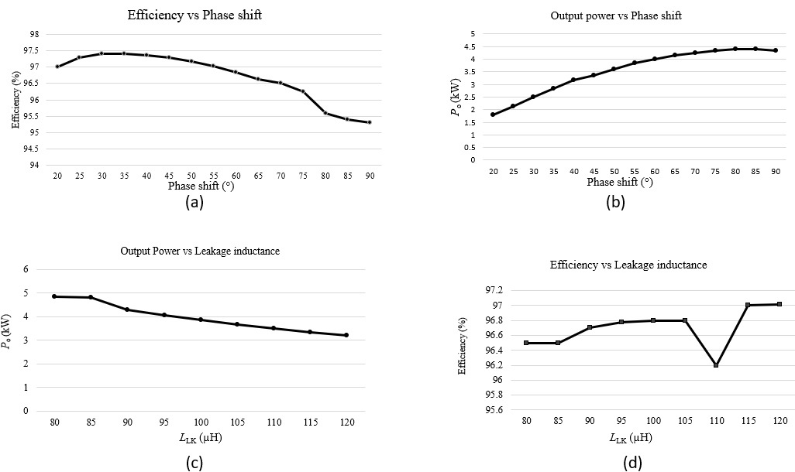
Simulation Results
10/12

Slide 13
Conclusion and Future Plan
Conclusion
The SiC-based DAB converter achieved high efficiency (≈96.8%) with optimized parameters of Llk = 95 µH and a phase shift of 63°, confirming its suitability for EV battery charging applications. All results presented were captured at steady-state. Lower inductance values (80 µH) allow for higher power output (4.84 kW), while higher values (120µH) restrict the power flow (3.2 kW). The analysis shows that an inductance of 95 µH provides a near-optimal efficiency of 96.78%. Although a slightly higher efficiency of 97.02% is observed at 120 µH, this comes at the cost of a significant reduction in power output. Under open-loop SPS control with the optimized parameters, the maximum achievable power is 4.12 kW, resulting in shortfall of 0.879 kW. To address this limitation and achieve precise and efficient battery charging, a transition from an open-loop to a closed-loop control strategy is required.
Future Plan
The next phase will involve hardware testing of the SiC-based DAB converter to experimentally validate its open-loop performance. A CC–CV charging control strategy will be developed and simulated in MATLAB/Simulink to enhance regulation accuracy and efficiency. The converter will be implemented with a closed-loop control and tested on a battery load setup for performance verification.
11/12

Slide 14
References
[1] | M. Kheraluwala, R. Gascoigne, D. Divan, and E. Baumann, “Performance characterization of a high-power dual active bridge dc-to-dc converter,” IEEE Transactions on Industry Applications, vol. 28, no. 6, pp. 1294–1301, 1992.
[2] | X. Chen, G. Xu, H. Han, D. Liu, Y. Sun, and M. Su, “Light-load efficiency enhancement of high-frequency dual-active-bridge converter under sps control,” IEEE Transactions on Industrial Electronics, vol. 68, no. 12, pp. 12941–12946, 2021.
[3] | B. Zhao, Q. Song, W. Liu, and Y. Sun, “Overview of dual-active-bridge isolated bidirectional dc–dc converter for high-frequency-link power-conversion system,” IEEE Transactions on Power Electronics, vol. 29, no. 8, pp. 4091–4106, 2014.
[4] | I. Kayaalp, T. Demirdelen, T. Koroglu, M. U. Cuma, K. C. Bayindir, and M. Tumay, “Comparison of different phase-shift control methods at isolated bidirectional dc-dc converter,” International Journal of Applied Methods in Electronics and Computers, vol. 4, pp. 68–73, Aug. 2016.

Slide 15
END OF PRESENTATION
THANK YOU

